Slide 1
Chapter 13 – Convolutional Layer

Slide 2
In This Chapter
Edge detection
Padding
Strided convolutions
Convolutions on multiple channels and multiple filters
Convolutional layer
Andrew Ng, deeplearning.ai

Slide 3
Why Convolution?
We have learned how to build DNNs (Deep Neural Networks). Great!
It may look that DNNs are the ultimate solution to recognition, classification and prediction problems.
However, if we try to analyze features in the images and object with DNNs, we may face both conceptual and technical problems:
On one hand, we have many parameters to optimize.
On the other hand, most of the parameters may be duplicative or redundant, or irrelevant.
How to focus on specific features?
These problems brought us to the Convolutional Neural Networks (CNNs)

Slide 4
Computer Vision Problems
Image classification
Edge detection
Object detection
Neural style transfer

Slide 5
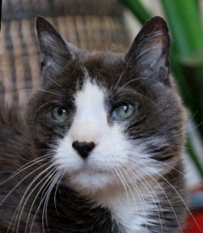
Computer Vision Problems: Large Images
Is it a cat?
W^{[1]}
W^{[2]}
W^{[3]}
W^{[L]}
x₁
x₂
X —‣ ŷ = P(cat = True | X)
…
a
x_{Nx}
A
Target output Y
N_{X}
N₁
N₂
N₃
N_{L}=1
Input X
Hidden layer [1]
Hidden layer [2]
Hidden layer [3]
Output layer [L]
Output A
If the image size is n x n pixels, then input X of size Nᵪ = n x n x 3.
With N₁ neurons in the first layer [1], the size of matrix W^{[1]} is Nᵪ x N₁
With a small image of size 64 x 64 pixels and 10 neurons in layer [1], the size of only W^{[1]} is 64*64*3*10 = 122,880.
With a reasonable 9 Megapixel image (3,000 x 3,000) and 100 neurons in layer [1], the size of only W^{[1]} is 9M*3*100 = 2.7 *10⁹ which is 2.7 billion.

Slide 6
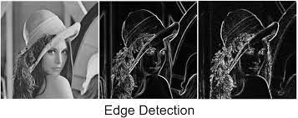
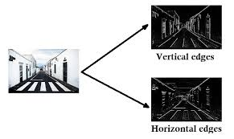
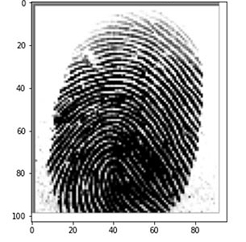
Computer Vision Problems: Edge Detection

Slide 7

Computer Vision Problems: Object Detection
Object detection is a computer vision technique for locating instances of objects in images or videos.
Object detection algorithms typically leverage machine learning or deep learning to produce meaningful results.

Slide 8
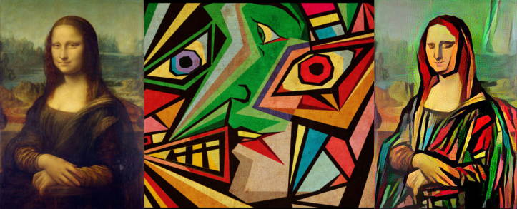
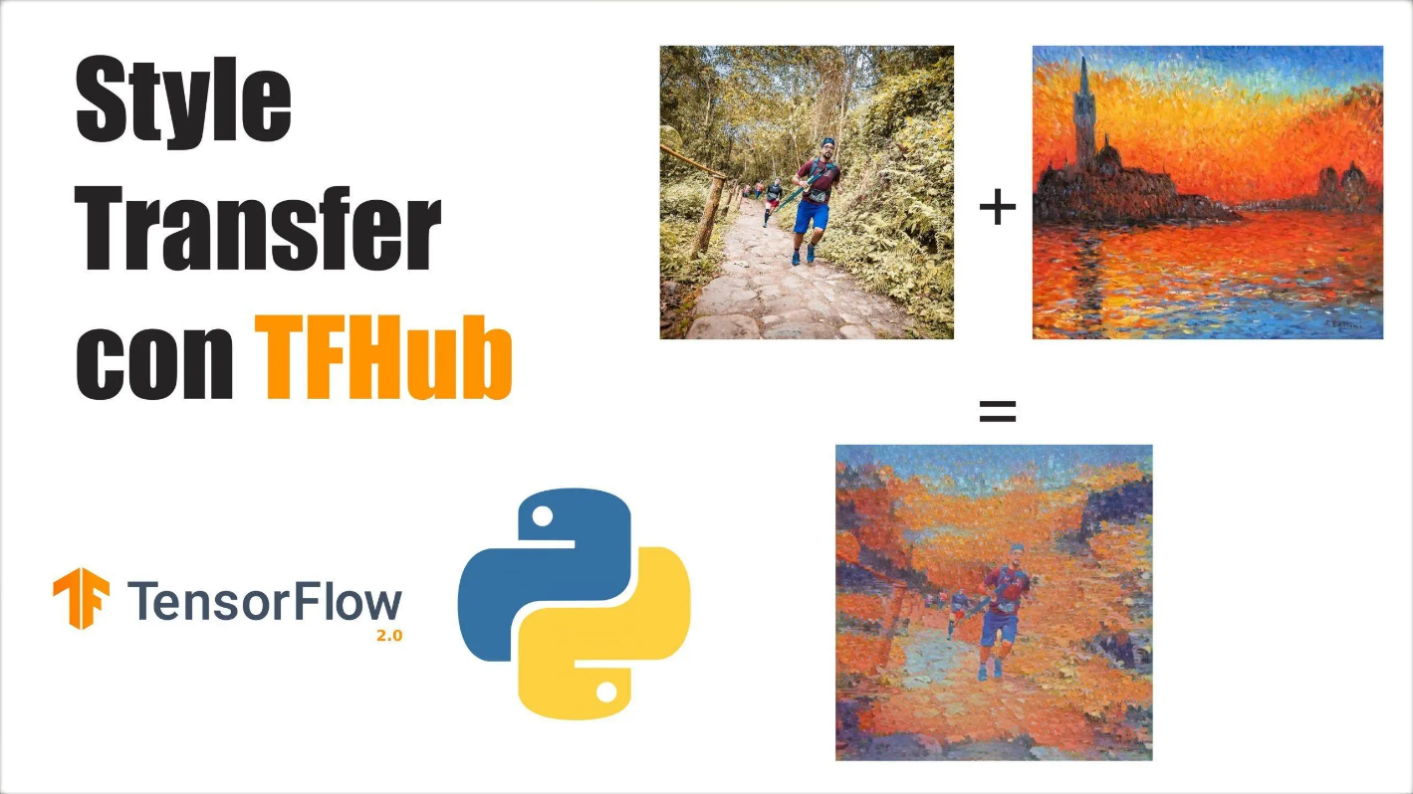

Computer Vision Problems: Neural Style Transfer
Original
Style sample
Original
Style sample

Slide 9
Operation of Convolution

Slide 10
Hadamard Product of Matrices
Hadamard product of two matrices of equal sizes is the by-component products of their elements
To allow for the Hadamard product A٥B both matrices A and B must be of the same size. The resultant matrix will be of the same size too.

Slide 11
What is Convolution?
Convolution is a particular type of operation that involves folding, shifting, multiplying, and adding.
A convolution operation consists of sliding a kernel (filter) across the width and height of an array and computing the sum of products of the corresponding intensities and weights.
How to perform convolution:
Flip the mask (horizontally and vertically) only once.
Slide the mask onto the image.
Multiply the corresponding elements (Hadamar product) and then add them.
Repeat this procedure until all values of the image has been calculated.

Slide 12
Example of Convolution – Flip 1
Kernel (filter) B of size f₁ x f₂
(f₁ ≤ n₁ and f₂ ≤ n₂)
Convoluted matrix C of size (n₁-f₁+1) x (n₂-f₂+1)
Application of a filter shrinks the original image by reducing its size (natural resolution)
Original matrix A of size n₁ x n₂
c₁₁ = a₁₁*b₁₁+a₁₂*b₁₂+a₂₁*b₂₁+a₂₂*b₂₂
c₁₂ = a₁₂*b₁₁+a₁₃*b₁₂+a₂₂*b₂₁+a₂₃*b₂₂
c₂₁ = a₂₁*b₁₁+a₂₂*b₁₂+a₃₁*b₂₁+a₃₂*b₂₂
c₂₂ = a₂₂*b₁₁+a₂₃*b₁₂+a₃₂*b₂₁+a₃₃*b₂₂
c₃₁ = a₃₁*b₁₁+a₃₂*b₁₂+a₄₁*b₂₁+a₄₂*b₂₂
c₃₂ = a₃₂*b₁₁+a₃₃*b₁₂+a₄₂*b₂₁+a₄₃*b₂₂
a₁₁ | a₁₂ | a₁₃
a₂₁ | a₂₂ | a₂₃
a₃₁ | a₃₂ | a₃₃
a₄₁ | a₄₂ | a₄₃
c₁₁ | c₁₂
c₂₁ | c₂₂
c₃₁ | c₃₂
b₁₁ | b₁₂
b₂₁ | b₂₂
=
*
Kernel (filter), say, 2 x 2
Original matrix, say, 4 x 3
Each element of the convoluted matrix equals the sum of all elements of the Hadamar product of the filter and its map on the original matrix.
Convoluted matrix C of size 3 x 2
Convolution operation

Slide 13
Example of Convolution – Flip 2
Kernel (filter) B of size f₁ x f₂
(f₁ ≤ n₁ and f₂ ≤ n₂)
Convoluted matrix C of size (n₁-f₁+1) x (n₂-f₂+1)
Application of a filter shrinks the original image by reducing its size (natural resolution)
Original matrix A of size n₁ x n₂
c₁₁ = a₁₁*b₁₁+a₁₂*b₁₂+a₂₁*b₂₁+a₂₂*b₂₂
c₁₂ = a₁₂*b₁₁+a₁₃*b₁₂+a₂₂*b₂₁+a₂₃*b₂₂
c₂₁ = a₂₁*b₁₁+a₂₂*b₁₂+a₃₁*b₂₁+a₃₂*b₂₂
c₂₂ = a₂₂*b₁₁+a₂₃*b₁₂+a₃₂*b₂₁+a₃₃*b₂₂
c₃₁ = a₃₁*b₁₁+a₃₂*b₁₂+a₄₁*b₂₁+a₄₂*b₂₂
c₃₂ = a₃₂*b₁₁+a₃₃*b₁₂+a₄₂*b₂₁+a₄₃*b₂₂
a₁₁ | a₁₂ | a₁₃
a₂₁ | a₂₂ | a₂₃
a₃₁ | a₃₂ | a₃₃
a₄₁ | a₄₂ | a₄₃
c₁₁ | c₁₂
c₂₁ | c₂₂
c₃₁ | c₃₂
b₁₁ | b₁₂
b₂₁ | b₂₂
=
*
Kernel (filter), say, 2 x 2
Original matrix, say, 4 x 3
Each element of the convoluted matrix equals the sum of all elements of the Hadamar product of the filter and its map on the original matrix.
Convoluted matrix C of size 3 x 2
Convolution operation

Slide 14
Example of Convolution – Flip 3
Kernel (filter) B of size f₁ x f₂
(f₁ ≤ n₁ and f₂ ≤ n₂)
Convoluted matrix C of size (n₁-f₁+1) x (n₂-f₂+1)
Application of a filter shrinks the original image by reducing its size (natural resolution)
Original matrix A of size n₁ x n₂
c₁₁ = a₁₁*b₁₁+a₁₂*b₁₂+a₂₁*b₂₁+a₂₂*b₂₂
c₁₂ = a₁₂*b₁₁+a₁₃*b₁₂+a₂₂*b₂₁+a₂₃*b₂₂
c₂₁ = a₂₁*b₁₁+a₂₂*b₁₂+a₃₁*b₂₁+a₃₂*b₂₂
c₂₂ = a₂₂*b₁₁+a₂₃*b₁₂+a₃₂*b₂₁+a₃₃*b₂₂
c₃₁ = a₃₁*b₁₁+a₃₂*b₁₂+a₄₁*b₂₁+a₄₂*b₂₂
c₃₂ = a₃₂*b₁₁+a₃₃*b₁₂+a₄₂*b₂₁+a₄₃*b₂₂
a₁₁ | a₁₂ | a₁₃
a₂₁ | a₂₂ | a₂₃
a₃₁ | a₃₂ | a₃₃
a₄₁ | a₄₂ | a₄₃
c₁₁ | c₁₂
c₂₁ | c₂₂
c₃₁ | c₃₂
b₁₁ | b₁₂
b₂₁ | b₂₂
=
*
Kernel (filter), say, 2 x 2
Original matrix, say, 4 x 3
Each element of the convoluted matrix equals the sum of all elements of the Hadamar product of the filter and its map on the original matrix.
Convoluted matrix C of size 3 x 2
Convolution operation

Slide 15
Example of Convolution – Flip 4
Kernel (filter) B of size f₁ x f₂
(f₁ ≤ n₁ and f₂ ≤ n₂)
Convoluted matrix C of size (n₁-f₁+1) x (n₂-f₂+1)
Application of a filter shrinks the original image by reducing its size (natural resolution)
Original matrix A of size n₁ x n₂
c₁₁ = a₁₁*b₁₁+a₁₂*b₁₂+a₂₁*b₂₁+a₂₂*b₂₂
c₁₂ = a₁₂*b₁₁+a₁₃*b₁₂+a₂₂*b₂₁+a₂₃*b₂₂
c₂₁ = a₂₁*b₁₁+a₂₂*b₁₂+a₃₁*b₂₁+a₃₂*b₂₂
c₂₂ = a₂₂*b₁₁+a₂₃*b₁₂+a₃₂*b₂₁+a₃₃*b₂₂
c₃₁ = a₃₁*b₁₁+a₃₂*b₁₂+a₄₁*b₂₁+a₄₂*b₂₂
c₃₂ = a₃₂*b₁₁+a₃₃*b₁₂+a₄₂*b₂₁+a₄₃*b₂₂
a₁₁ | a₁₂ | a₁₃
a₂₁ | a₂₂ | a₂₃
a₃₁ | a₃₂ | a₃₃
a₄₁ | a₄₂ | a₄₃
c₁₁ | c₁₂
c₂₁ | c₂₂
c₃₁ | c₃₂
b₁₁ | b₁₂
b₂₁ | b₂₂
=
*
Kernel (filter), say, 2 x 2
Original matrix, say, 4 x 3
Each element of the convoluted matrix equals the sum of all elements of the Hadamar product of the filter and its map on the original matrix.
Convoluted matrix C of size 3 x 2
Convolution operation

Slide 16
Example of Convolution – Flip 5
Kernel (filter) B of size f₁ x f₂
(f₁ ≤ n₁ and f₂ ≤ n₂)
Convoluted matrix C of size (n₁-f₁+1) x (n₂-f₂+1)
Application of a filter shrinks the original image by reducing its size (natural resolution)
Original matrix A of size n₁ x n₂
c₁₁ = a₁₁*b₁₁+a₁₂*b₁₂+a₂₁*b₂₁+a₂₂*b₂₂
c₁₂ = a₁₂*b₁₁+a₁₃*b₁₂+a₂₂*b₂₁+a₂₃*b₂₂
c₂₁ = a₂₁*b₁₁+a₂₂*b₁₂+a₃₁*b₂₁+a₃₂*b₂₂
c₂₂ = a₂₂*b₁₁+a₂₃*b₁₂+a₃₂*b₂₁+a₃₃*b₂₂
c₃₁ = a₃₁*b₁₁+a₃₂*b₁₂+a₄₁*b₂₁+a₄₂*b₂₂
c₃₂ = a₃₂*b₁₁+a₃₃*b₁₂+a₄₂*b₂₁+a₄₃*b₂₂
a₁₁ | a₁₂ | a₁₃
a₂₁ | a₂₂ | a₂₃
a₃₁ | a₃₂ | a₃₃
a₄₁ | a₄₂ | a₄₃
c₁₁ | c₁₂
c₂₁ | c₂₂
c₃₁ | c₃₂
b₁₁ | b₁₂
b₂₁ | b₂₂
=
*
Kernel (filter), say, 2 x 2
Original matrix, say, 4 x 3
Each element of the convoluted matrix equals the sum of all elements of the Hadamar product of the filter and its map on the original matrix.
Convoluted matrix C of size 3 x 2
Convolution operation

Slide 17
Example of Convolution – Flip 6
Kernel (filter) B of size f₁ x f₂
(f₁ ≤ n₁ and f₂ ≤ n₂)
Convoluted matrix C of size (n₁-f₁+1) x (n₂-f₂+1)
Application of a filter shrinks the original image by reducing its size (natural resolution)
Original matrix A of size n₁ x n₂
c₁₁ = a₁₁*b₁₁+a₁₂*b₁₂+a₂₁*b₂₁+a₂₂*b₂₂
c₁₂ = a₁₂*b₁₁+a₁₃*b₁₂+a₂₂*b₂₁+a₂₃*b₂₂
c₂₁ = a₂₁*b₁₁+a₂₂*b₁₂+a₃₁*b₂₁+a₃₂*b₂₂
c₂₂ = a₂₂*b₁₁+a₂₃*b₁₂+a₃₂*b₂₁+a₃₃*b₂₂
c₃₁ = a₃₁*b₁₁+a₃₂*b₁₂+a₄₁*b₂₁+a₄₂*b₂₂
c₃₂ = a₃₂*b₁₁+a₃₃*b₁₂+a₄₂*b₂₁+a₄₃*b₂₂
a₁₁ | a₁₂ | a₁₃
a₂₁ | a₂₂ | a₂₃
a₃₁ | a₃₂ | a₃₃
a₄₁ | a₄₂ | a₄₃
c₁₁ | c₁₂
c₂₁ | c₂₂
c₃₁ | c₃₂
b₁₁ | b₁₂
b₂₁ | b₂₂
=
*
Kernel (filter), say, 2 x 2
Original matrix, say, 4 x 3
Each element of the convoluted matrix equals the sum of all elements of the Hadamar product of the filter and its map on the original matrix.
Convoluted matrix C of size 3 x 2
Convolution operation

Slide 18
Example of Convolution – Flip 2
Kernel (filter) B of size f₁ x f₂
(f₁ ≤ n₁ and f₂ ≤ n₂)
Convoluted matrix C of size (n₁-f₁+1) x (n₂-f₂+1)
Application of a filter shrinks the original image by reducing its size (natural resolution)
Original matrix A of size n₁ x n₂
c₁₁ = a₁₁*b₁₁+a₁₂*b₁₂+a₂₁*b₂₁+a₂₂*b₂₂
c₁₂ = a₁₂*b₁₁+a₁₃*b₁₂+a₂₂*b₂₁+a₂₃*b₂₂
c₂₁ = a₂₁*b₁₁+a₂₂*b₁₂+a₃₁*b₂₁+a₃₂*b₂₂
c₂₂ = a₂₂*b₁₁+a₂₃*b₁₂+a₃₂*b₂₁+a₃₃*b₂₂
c₃₁ = a₃₁*b₁₁+a₃₂*b₁₂+a₄₁*b₂₁+a₄₂*b₂₂
c₃₂ = a₃₂*b₁₁+a₃₃*b₁₂+a₄₂*b₂₁+a₄₃*b₂₂
a₁₁ | a₁₂ | a₁₃
a₂₁ | a₂₂ | a₂₃
a₃₁ | a₃₂ | a₃₃
a₄₁ | a₄₂ | a₄₃
c₁₁ | c₁₂
c₂₁ | c₂₂
c₃₁ | c₃₂
b₁₁ | b₁₂
b₂₁ | b₂₂
=
*
Kernel (filter), say, 2 x 2
Original matrix, say, 4 x 3
Each element of the convoluted matrix equals the sum of all elements of the Hadamar product of the filter and its map on the original matrix.
Convoluted matrix C of size 3 x 2
Convolution operation

Slide 19
Example of Convolution – Flip 2
Kernel (filter) B of size f₁ x f₂
(f₁ ≤ n₁ and f₂ ≤ n₂)
Convoluted matrix C of size (n₁-f₁+1) x (n₂-f₂+1)
Application of a filter shrinks the original image by reducing its size (natural resolution)
Original matrix A of size n₁ x n₂
c₁₁ = a₁₁*b₁₁+a₁₂*b₁₂+a₂₁*b₂₁+a₂₂*b₂₂
c₁₂ = a₁₂*b₁₁+a₁₃*b₁₂+a₂₂*b₂₁+a₂₃*b₂₂
c₂₁ = a₂₁*b₁₁+a₂₂*b₁₂+a₃₁*b₂₁+a₃₂*b₂₂
c₂₂ = a₂₂*b₁₁+a₂₃*b₁₂+a₃₂*b₂₁+a₃₃*b₂₂
c₃₁ = a₃₁*b₁₁+a₃₂*b₁₂+a₄₁*b₂₁+a₄₂*b₂₂
c₃₂ = a₃₂*b₁₁+a₃₃*b₁₂+a₄₂*b₂₁+a₄₃*b₂₂
a₁₁ | a₁₂ | a₁₃
a₂₁ | a₂₂ | a₂₃
a₃₁ | a₃₂ | a₃₃
a₄₁ | a₄₂ | a₄₃
c₁₁ | c₁₂
c₂₁ | c₂₂
c₃₁ | c₃₂
b₁₁ | b₁₂
b₂₁ | b₂₂
=
*
Kernel (filter), say, 2 x 2
Original matrix, say, 4 x 3
Each element of the convoluted matrix equals the sum of all elements of the Hadamar product of the filter and its map on the original matrix.
Convoluted matrix C of size 3 x 2
Convolution operation

Slide 20

Convolution – Visual Experience
https://medium.com/@ianormy/convolution-filters-4971820e851f

Slide 21
Edge Detection

Slide 22
Vertical and Horizontal Edge Detection

Slide 23
Vertical Edge Detection: Image
Suppose we have a 6 x 6 grey-scale image encoded as
3 | 0 | 1 | 2 | 7 | 4
1 | 5 | 8 | 9 | 3 | 1
2 | 7 | 2 | 5 | 1 | 3
0 | 1 | 3 | 1 | 7 | 8
4 | 2 | 1 | 6 | 2 | 8
2 | 4 | 5 | 2 | 3 | 9
As soon as it is a grey-scale image, it has only one “color” layer, thus, it is a 6 x 6 x 1 image

Slide 24
Vertical Edge Detection: Filter (Kernel)
Convolution operation
Let’s use a 3 x 3 “vertical-edge” filter (or kernel) which looks as follows
3 | 0 | 1 | 2 | 7 | 4
1 | 5 | 8 | 9 | 3 | 1
2 | 7 | 2 | 5 | 1 | 3
0 | 1 | 3 | 1 | 7 | 8
4 | 2 | 1 | 6 | 2 | 8
2 | 4 | 5 | 2 | 3 | 9
1 | 0 | -1
1 | 0 | -1
1 | 0 | -1
*
3 x 3
… and convolve the original 6 x 6 image using this 3 x 3 filter by applying the convolution operation ‘*’.
6 x 6

Slide 25
Vertical Edge Detection: Convolution – Flip 1
Let’s use a 3 x 3 “vertical-edge” filter (or kernel) which looks as follows
3*1+1*1+2*1+0*5*0+8*0+1*(-1)+8*(-1)+2*(-1) = -5
3 | 0 | 1 | 2 | 7 | 4
1 | 5 | 8 | 9 | 3 | 1
2 | 7 | 2 | 5 | 1 | 3
0 | 1 | 3 | 1 | 7 | 8
4 | 2 | 1 | 6 | 2 | 8
2 | 4 | 5 | 2 | 3 | 9
-5
1 | 0 | -1
1 | 0 | -1
1 | 0 | -1
=
*
3 x 3
4 x 4
… and convolve the original 6 x 6 image using this 3 x 3 filter by applying the convolution operation ‘*’.
6 x 6

Slide 26
Vertical Edge Detection: Convolution – Flip 2
Let’s use a 3 x 3 “vertical-edge” filter (or kernel) which looks as follows
1*1+2*1+0*1+5*0+7*0+1*0+8*(-1)+2*(-1)+3*(-1) = -5
3 | 0 | 1 | 2 | 7 | 4
1 | 5 | 8 | 9 | 3 | 1
2 | 7 | 2 | 5 | 1 | 3
0 | 1 | 3 | 1 | 7 | 8
4 | 2 | 1 | 6 | 2 | 8
2 | 4 | 5 | 2 | 3 | 9
-5
-10
1 | 0 | -1
1 | 0 | -1
1 | 0 | -1
=
*
3 x 3
4 x 4
… and convolve the original 6 x 6 image using this 3 x 3 filter by applying the convolution operation ‘*’.
6 x 6

Slide 27
Vertical Edge Detection: Convolution – Flip 16
Let’s use a 3 x 3 “vertical-edge” filter (or kernel) which looks as follows
1*1+6*1+2*1+7*0+2*0+3*0+8*(-1)+8*(-1)+9*(-1) = -16
3 | 0 | 1 | 2 | 7 | 4
1 | 5 | 8 | 9 | 3 | 1
2 | 7 | 2 | 5 | 1 | 3
0 | 1 | 3 | 1 | 7 | 8
4 | 2 | 1 | 6 | 2 | 8
2 | 4 | 5 | 2 | 3 | 9
-5
-10
 |  |  | -16
1 | 0 | -1
1 | 0 | -1
1 | 0 | -1
=
*
3 x 3
4 x 4
… and convolve the original 6 x 6 image using this 3 x 3 filter by applying the convolution operation ‘*’.
6 x 6

Slide 28
Vertical Edge Detection: Convolution – Result
Do not worry about negative pixels. We normalize them to map to interval (0,255)
Let’s use a 3 x 3 “vertical-edge” filter (or kernel) which looks as follows
A 6 x 6 grey-scale image
Convoluted matrix
3 | 0 | 1 | 2 | 7 | 4
1 | 5 | 8 | 9 | 3 | 1
2 | 7 | 2 | 5 | 1 | 3
0 | 1 | 3 | 1 | 7 | 8
4 | 2 | 1 | 6 | 2 | 8
2 | 4 | 5 | 2 | 3 | 9
-5 | -4 | 0 | 8
-10 | -2 | 2 | 3
0 | -2 | -4 | -7
3 | -2 | -3 | -16
1 | 0 | -1
1 | 0 | -1
1 | 0 | -1
=
*
3 x 3
4 x 4
The lighter pixels (higher numbers in the convoluted matrix) represent vertical edges
… and convolve the original 6 x 6 image using this 3 x 3 filter by applying the convolution operation ‘*’.
6 x 6

Slide 29
A Vivid Example of Vertical Edge Detection (1/4)
A 6 x 6 grey-scale image
We use a 3 x 3 “vertical-edge” filter (or kernel)
Convoluted matrix
10 | 10 | 10 | 0 | 0 | 0
10 | 10 | 10 | 0 | 0 | 0
10 | 10 | 10 | 0 | 0 | 0
10 | 10 | 10 | 0 | 0 | 0
10 | 10 | 10 | 0 | 0 | 0
10 | 10 | 10 | 0 | 0 | 0
0 | 30 | 30 | 0
0 | 30 | 30 | 0
0 | 30 | 30 | 0
0 | 30 | 30 | 0
1 | 0 | -1
1 | 0 | -1
1 | 0 | -1
=
*
3 x 3
4 x 4
6 x 6

Slide 30
A Vivid Example of Vertical Edge Detection (2/4)
A 6 x 6 grey-scale image
We use a 3 x 3 “vertical-edge” filter (or kernel)
Convoluted matrix
10 | 10 | 10 | 0 | 0 | 0
10 | 10 | 10 | 0 | 0 | 0
10 | 10 | 10 | 0 | 0 | 0
10 | 10 | 10 | 0 | 0 | 0
10 | 10 | 10 | 0 | 0 | 0
10 | 10 | 10 | 0 | 0 | 0
0 | -30 | -30 | 0
0 | -30 | -30 | 0
0 | -30 | -30 | 0
0 | -30 | -30 | 0
-1 | 0 | 1
-1 | 0 | 1
-1 | 0 | 1
=
*
3 x 3
4 x 4
6 x 6

Slide 31
A Vivid Example of Vertical Edge Detection (1/4)
A 6 x 6 grey-scale image
We use a 3 x 3 “vertical-edge” filter (or kernel)
Convoluted matrix
0 | 0 | 0 | 10 | 10 | 10
0 | 0 | 0 | 10 | 10 | 10
0 | 0 | 0 | 10 | 10 | 10
0 | 0 | 0 | 10 | 10 | 10
0 | 0 | 0 | 10 | 10 | 10
0 | 0 | 0 | 10 | 10 | 10
0 | -30 | -30 | 0
0 | -30 | -30 | 0
0 | -30 | -30 | 0
0 | -30 | -30 | 0
1 | 0 | -1
1 | 0 | -1
1 | 0 | -1
=
*
3 x 3
4 x 4
6 x 6

Slide 32
A Vivid Example of Vertical Edge Detection (4/4)
A 6 x 6 grey-scale image
We use a 3 x 3 “vertical-edge” filter (or kernel)
Convoluted matrix
0 | 0 | 0 | 10 | 10 | 10
0 | 0 | 0 | 10 | 10 | 10
0 | 0 | 0 | 10 | 10 | 10
0 | 0 | 0 | 10 | 10 | 10
0 | 0 | 0 | 10 | 10 | 10
0 | 0 | 0 | 10 | 10 | 10
0 | 30 | 30 | 0
0 | 30 | 30 | 0
0 | 30 | 30 | 0
0 | 30 | 30 | 0
-1 | 0 | 1
-1 | 0 | 1
-1 | 0 | 1
=
*
3 x 3
4 x 4
6 x 6

Slide 33
Horizontal Edge Detection (1/3)
A 6 x 6 grey-scale image
We use a 3 x 3 “horizontal-edge” filter (or kernel)
Convoluted matrix
10 | 10 | 10 | 10 | 10 | 10
10 | 10 | 10 | 10 | 10 | 10
10 | 10 | 10 | 10 | 10 | 10
0 | 0 | 0 | 0 | 0 | 0
0 | 0 | 0 | 0 | 0 | 0
0 | 0 | 0 | 0 | 0 | 0
0 | 0 | 0 | 0
30 | 30 | 30 | 30
30 | 30 | 30 | 30
0 | 0 | 0 | 0
1 | 1 | 1
0 | 0 | 0
-1 | -1 | -1
=
*
3 x 3
4 x 4
6 x 6

Slide 34
Horizontal Edge Detection (2/3)
A 6 x 6 grey-scale image
We use a 3 x 3 “horizontal-edge” filter (or kernel)
Convoluted matrix
10 | 10 | 10 | 10 | 10 | 10
10 | 10 | 10 | 10 | 10 | 10
10 | 10 | 10 | 10 | 10 | 10
0 | 0 | 0 | 0 | 0 | 0
0 | 0 | 0 | 0 | 0 | 0
0 | 0 | 0 | 0 | 0 | 0
0 | 0 | 0 | 0
-30 | -30 | -30 | -30
-30 | -30 | -30 | -30
0 | 0 | 0 | 0
-1 | -1 | -1
0 | 0 | 0
1 | 1 | 1
=
*
3 x 3
4 x 4
6 x 6

Slide 35
Horizontal Edge Detection
A 6 x 6 grey-scale image
We use a 3 x 3 “horizontal-edge” filter (or kernel)
Convoluted matrix
10 | 10 | 10 | 0 | 0 | 0
10 | 10 | 10 | 0 | 0 | 0
10 | 10 | 10 | 0 | 0 | 0
0 | 0 | 0 | 10 | 10 | 10
0 | 0 | 0 | 10 | 10 | 10
0 | 0 | 0 | 10 | 10 | 10
0 | 0 | 0 | 0
30 | 10 | -10 | -30
30 | 10 | -10 | -30
0 | 0 | 0 | 0
1 | 1 | 1
0 | 0 | 0
-1 | -1 | -1
=
*
3 x 3
4 x 4
6 x 6

Slide 36
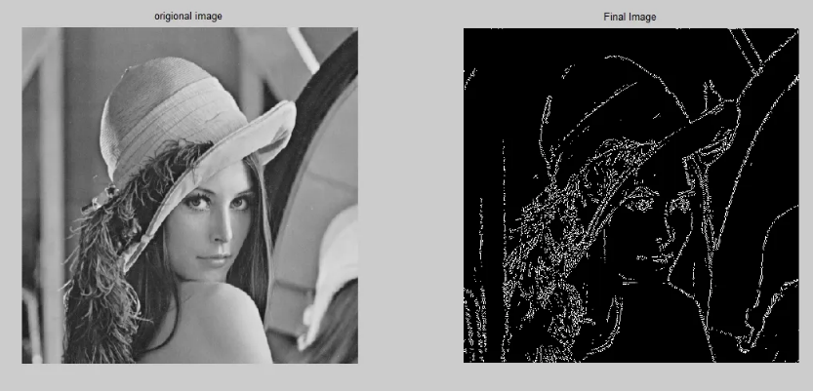
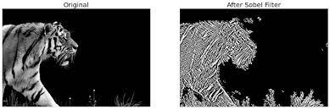
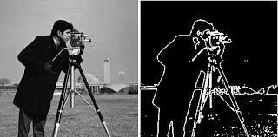
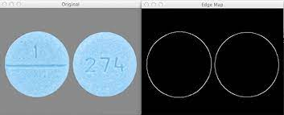
Edge Detection Examples

Slide 37
Leaning to Detect Any Edges

Slide 38
Variety of Edge Detection Filters (Kernels)
Vertical
Horizontal
45 Degree
There is a broad variety of edge filters
vertical
horizontal
angular
other
There are many variations of filters in each former category.
Filter sizes may vary too.
1 | 0 | -1
1 | 0 | -1
1 | 0 | -1
1 | 1 | 1
0 | 0 | 0
-1 | -1 | -1
1 | 1 | 0
1 | 0 | -1
0 | -1 | -1
Sharpening
Means Blur
0 | -1 | 0
-1 | 5 | -1
0 | -1 | 0
1/9 | 1/9 | 1/9
1/9 | 1/9 | 1/9
1/9 | 1/9 | 1/9
Sobel
Scharr
1 | 0 | -1
2 | 0 | -2
1 | 0 | -1
3 | 0 | -3
10 | 0 | -10
3 | 0 | -3

Slide 39
Sobel and Scharr Filters
Sobel Filter
The Sobel operator performs a 2-D spatial gradient measurement on an image and so emphasizes regions of high spatial frequency that correspond to edges.
Typically, it is used to find the approximate absolute gradient magnitude at each point in an input grayscale image.
Scharr Filter
This is a filtering method used to identify and highlight gradient edges/features using the first derivative.
Scharr filter is said to give more accurate results where Sobel filter fails to work correctly.
Performance is quite similar to the Sobel filter.
https://medium.com/@ianormy/convolution-filters-4971820e851f

Slide 40
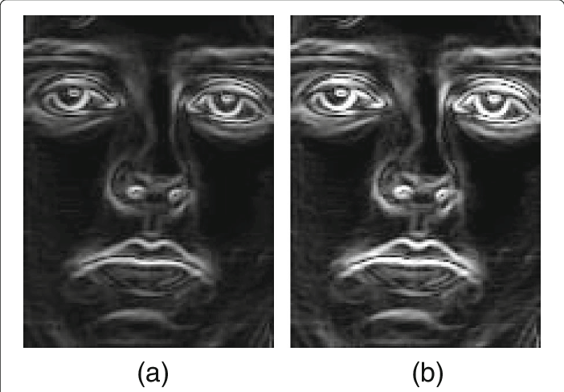
Sobel and Scharr Filters
Filters:
(a) Sobel
(b) Scharr
https://www.researchgate.net/figure/a-Sobel-gradient-magnitude-image-b-Scharr-gradient-magnitude-image_fig3_318162947

Slide 41
Learning Filters to Detect Edges
One can manually select or adjust filters to obtain the desired result.
Alternatively, we may train the system to a specific filter for predefined results using supervised learning.
Given matrix X as input, desired convoluted matrix Y as the labeled output, find filter W.
Y
W
X
x₁₁ | x₁₂ | x₁₃ | x₁₄ | x₁₅ | x₁₆
x₂₁ | x₂₂ | x₂₃ | x₂₄ | x₂₅ | x₂₆
x₃₁ | x₃₂ | x₃₃ | x₃₄ | x₃₅ | x₃₆
x₄₁ | x₄₂ | x₄₃ | x₄₄ | x₄₅ | x₄₆
x₅₁ | x₅₂ | x₅₃ | x₅₄ | x₅₅ | x₅₆
x₆₁ | x₆₂ | x₆₃ | x₆₄ | x₆₅ | x₆₆
y₁₁ | y₁₂ | y₁₃ | y₁₄
y₂₁ | y₂₂ | y₂₃ | y₂₄
y₃₁ | y₃₂ | y₃₃ | y₃₄
y₄₁ | y₄₂ | y₄₃ | y₄₄
w₁₁ | w₁₂ | w₁₃
w₂₁ | w₂₂ | w₂₃
w₃₁ | w₃₂ | w₃₃
=
*

Slide 42
Padding

Slide 43
Image (Pattern) Padding
Padding an image is adding a border around it. This can be necessary for a number of reasons:
The image is going to be rotated and you do not want the corners to be cut off.
Padding can help in reducing the loss of information at the borders of the input feature map and can improve the performance of the model.
For example, in convolution operations.
Convolution without padding shrinks the image.
Padding helps keeping the image size and information in its borders.

Slide 44
Reason for Padding in Convolutional NN (CNN)
Convolution operation performed several times on an image in a CNN would dramatically reduce the image size.
Padding prevents such an effect and helps keeping the image size.
*
*
*
Filter 1 Filter 2 Filter 3
Convoluted image
Convoluted image
Original image
Convoluted image

Slide 45
Padding
Image X padded with one pixel
Image X
 | x₁₁ | x₁₂ | x₁₃ | x₁₄ | x₁₅ | x₁₆
 | x₂₁ | x₂₂ | x₂₃ | x₂₄ | x₂₅ | x₂₆
 | x₃₁ | x₃₂ | x₃₃ | x₃₄ | x₃₅ | x₃₆
 | x₄₁ | x₄₂ | x₄₃ | x₄₄ | x₄₅ | x₄₆
 | x₅₁ | x₅₂ | x₅₃ | x₅₄ | x₅₅ | x₅₆
 | x₆₁ | x₆₂ | x₆₃ | x₆₄ | x₆₅ | x₆₆
x₁₁ | x₁₂ | x₁₃ | x₁₄ | x₁₅ | x₁₆
x₂₁ | x₂₂ | x₂₃ | x₂₄ | x₂₅ | x₂₆
x₃₁ | x₃₂ | x₃₃ | x₃₄ | x₃₅ | x₃₆
x₄₁ | x₄₂ | x₄₃ | x₄₄ | x₄₅ | x₄₆
x₅₁ | x₅₂ | x₅₃ | x₅₄ | x₅₅ | x₅₆
x₆₁ | x₆₂ | x₆₃ | x₆₄ | x₆₅ | x₆₆
Padding an image with 1 pixel means adding 1 pixel around the image.

Slide 46
Padding Initialization
Image X padded with one pixel
Image X
0 | 0 | 0 | 0 | 0 | 0 | 0 | 0
0 | x₁₁ | x₁₂ | x₁₃ | x₁₄ | x₁₅ | x₁₆ | 0
0 | x₂₁ | x₂₂ | x₂₃ | x₂₄ | x₂₅ | x₂₆ | 0
0 | x₃₁ | x₃₂ | x₃₃ | x₃₄ | x₃₅ | x₃₆ | 0
0 | x₄₁ | x₄₂ | x₄₃ | x₄₄ | x₄₅ | x₄₆ | 0
0 | x₅₁ | x₅₂ | x₅₃ | x₅₄ | x₅₅ | x₅₆ | 0
0 | x₆₁ | x₆₂ | x₆₃ | x₆₄ | x₆₅ | x₆₆ | 0
0 | 0 | 0 | 0 | 0 | 0 | 0 | 0
x₁₁ | x₁₂ | x₁₃ | x₁₄ | x₁₅ | x₁₆
x₂₁ | x₂₂ | x₂₃ | x₂₄ | x₂₅ | x₂₆
x₃₁ | x₃₂ | x₃₃ | x₃₄ | x₃₅ | x₃₆
x₄₁ | x₄₂ | x₄₃ | x₄₄ | x₄₅ | x₄₆
x₅₁ | x₅₂ | x₅₃ | x₅₄ | x₅₅ | x₅₆
x₆₁ | x₆₂ | x₆₃ | x₆₄ | x₆₅ | x₆₆
Padding an image with 1 pixel means adding 1 pixel around the image.
Typically, the padded pixels are initialized with 0.

Slide 47
Padding with 2 Pixels
Image X padded with 2 pixels
Image X
0 | 0 | 0 | 0 | 0 | 0 | 0 | 0 | 0 | 0
0 | 0 | 0 | 0 | 0 | 0 | 0 | 0 | 0 | 0
0 | 0 | x₁₁ | x₁₂ | x₁₃ | x₁₄ | x₁₅ | x₁₆ | 0 | 0
0 | 0 | x₂₁ | x₂₂ | x₂₃ | x₂₄ | x₂₅ | x₂₆ | 0 | 0
0 | 0 | x₃₁ | x₃₂ | x₃₃ | x₃₄ | x₃₅ | x₃₆ | 0 | 0
0 | 0 | x₄₁ | x₄₂ | x₄₃ | x₄₄ | x₄₅ | x₄₆ | 0 | 0
0 | 0 | x₅₁ | x₅₂ | x₅₃ | x₅₄ | x₅₅ | x₅₆ | 0 | 0
0 | 0 | x₆₁ | x₆₂ | x₆₃ | x₆₄ | x₆₅ | x₆₆ | 0 | 0
0 | 0 | 0 | 0 | 0 | 0 | 0 | 0 | 0 | 0
0 | 0 | 0 | 0 | 0 | 0 | 0 | 0 | 0 | 0
x₁₁ | x₁₂ | x₁₃ | x₁₄ | x₁₅ | x₁₆
x₂₁ | x₂₂ | x₂₃ | x₂₄ | x₂₅ | x₂₆
x₃₁ | x₃₂ | x₃₃ | x₃₄ | x₃₅ | x₃₆
x₄₁ | x₄₂ | x₄₃ | x₄₄ | x₄₅ | x₄₆
x₅₁ | x₅₂ | x₅₃ | x₅₄ | x₅₅ | x₅₆
x₆₁ | x₆₂ | x₆₃ | x₆₄ | x₆₅ | x₆₆
Padding an image with 2 pixels means adding a 2-pixel layer around the image.

Slide 48
Convolution with Padding
Original image Filter Convoluted
6 X 6 3 X 3 image 4 X 4
Convolution of an original 6 x 6 image with a 3 x 3 filter results in a reduced size image matrix 4 x 4.
3 | 0 | 1 | 2 | 7 | 4
1 | 5 | 7 | 9 | 3 | 1
2 | 7 | 2 | 5 | 1 | 3
0 | 1 | 3 | 1 | 7 | 8
4 | 2 | 1 | 6 | 2 | 8
2 | 4 | 5 | 2 | 3 | 9
-5
1 | 0 | -1
1 | 0 | -1
1 | 0 | -1
=
An n₁ x n₂ image matrix convoluted with an f₁ x f₂ filter has size (n₁-f₁+1) x (n₂-f₂+1)
*
Padded image Filter Convoluted
6 X 6 (8 x 8) 3 X 3 image 6 X 6
Convolution of a padded with 1 pixel 6 x 6 image with a 3 x 3 filter results in the original size image matrix 6 x 6.
0 | 0 | 0 | 0 | 0 | 0 | 0 | 0
0 | 3 | 0 | 1 | 2 | 7 | 4 | 0
0 | 1 | 5 | 7 | 9 | 3 | 1 | 0
0 | 2 | 7 | 2 | 5 | 1 | 3 | 0
0 | 0 | 1 | 3 | 1 | 7 | 8 | 0
0 | 4 | 2 | 1 | 6 | 2 | 8 | 0
0 | 2 | 4 | 5 | 2 | 3 | 9 | 0
0 | 0 | 0 | 0 | 0 | 0 | 0 | 0
-4
 | -5
An n₁ x n₂ image matrix padded with p pixels convoluted with an f₁ x f₂ filter has size (n₁+2p-f₁+1) x (n₂+2p-f₂+1)
1 | 0 | -1
1 | 0 | -1
1 | 0 | -1
=
*

Slide 49

Convolution with Padding
Kernel Size: The kernel size defines the field of view of the convolution. A common choice for 2D is 3 — that is 3x3 pixels.
Stride: The stride defines the step size of the kernel when traversing the image. While its default is usually 1, we can use a stride of 2 for downsampling an image similar to MaxPooling.
Padding: The padding defines how the border of a sample is handled. A (half) padded convolution will keep the spatial output dimensions equal to the input, whereas unpadded convolutions will crop away some of the borders if the kernel is larger than 1.
Input & Output Channels: A convolutional layer takes a certain number of input channels (I) and calculates a specific number of output channels (O). The needed parameters for such a layer can be calculated by I*O*K, where K equals the number of values in the kernel.
https://towardsdatascience.com/types-of-convolutions-in-deep-learning-717013397f4d

Slide 50
Calculating the Padding to Keep the Image Size
An image of size n₁ x n₂ convoluted padded with p pixels and convoluted with a filter of size f₁ x f₂ results in the image of size (n₁+2p-f₁+1) x (n₂+2p-f₂+1).
To keep the size of the convoluted image the same as the original one, the following equations should take place
Padded Filter Convoluted
image image
n₁ + 2p - f₁ + 1 = n₁
n₂ + 2p - f₂ + 1 = n₂
Hence the padding size can be expressed as
p = (f₁ - 1)/2 = (f₂ - 1)/2
Thus, the filter must be a square-filter, i.e. f₁ = f₂ = f
0 | 0 | 0 | 0 | 0 | 0 | 0 | 0
0 | 3 | 0 | 1 | 2 | 7 | 4 | 0
0 | 1 | 5 | 7 | 9 | 3 | 1 | 0
0 | 2 | 7 | 2 | 5 | 1 | 3 | 0
0 | 0 | 1 | 3 | 1 | 7 | 8 | 0
0 | 4 | 2 | 1 | 6 | 2 | 8 | 0
0 | 2 | 4 | 5 | 2 | 3 | 9 | 0
0 | 0 | 0 | 0 | 0 | 0 | 0 | 0
-4
 | -5
*
1 | 0 | -1
1 | 0 | -1
1 | 0 | -1
=
The size keeping filter must be square, i.e. f₁=f₂=f
The size keeping padding size p = (f - 1)/2
The image itself can be of any size and ratio
p = (f₁ - 1)/2

Slide 51

Dilated Convolutions
Dilated convolutions introduce another parameter to convolutional layers called the dilation rate.
This defines a spacing between the values in a kernel.
A 3x3 kernel with a dilation rate of 2 will have the same field of view as a 5x5 kernel, while only using 9 parameters. Imagine taking a 5x5 kernel and deleting every second column and row.
https://towardsdatascience.com/types-of-convolutions-in-deep-learning-717013397f4d

Slide 52
Strided Convolution

Slide 53
From Standard to Strided Convolution
Standard convolution
In standard convolution, the filter moves one pixel per each convolution step across the image.
Strided convolution
What if the filter moves by a bigger stride each step, say, by 2 pixels per each convolution step.
2 pixels per step
Filter
Filter
*
=
=
*
3 x 3
3 x 3
3 x 3
5 x 5
7 x 7
7 x 7

Slide 54
From Standard to Strided Convolution
Standard convolution
In standard convolution, the filter moves one pixel per each convolution step across the image.
Strided convolution
What if the filter moves by a bigger stride each step, say, by 2 pixels per each convolution step.
1 pixel per step
2 pixels per step
Filter
Filter
*
=
=
*
3 x 3
3 x 3
3 x 3
5 x 5
7 x 7
7 x 7

Slide 55
From Standard to Strided Convolution
Standard convolution
In standard convolution, the filter moves one pixel per each convolution step across the image.
Strided convolution
What if the filter moves by a bigger stride each step, say, by 2 pixels per each convolution step.
1 pixel per step
2 pixels per step
Filter
Filter
*
=
=
*
3 x 3
3 x 3
3 x 3
5 x 5
7 x 7
7 x 7

Slide 56
From Standard to Strided Convolution
Standard convolution
In standard convolution, the filter moves one pixel per each convolution step across the image.
Strided convolution
What if the filter moves by a bigger stride each step, say, by 2 pixels per each convolution step.
1 pixel per step
2 pixels per step
Filter
Filter
*
=
=
*
3 x 3
3 x 3
3 x 3
5 x 5
7 x 7
7 x 7

Slide 57
Strided Convolution (Stride = 2)
7 x 7
Filter
Filter
Filter
*
=
*
=
*
=
3 x 3
3 x 3
3 x 3
3 x 3
3 x 3
3 x 3
7 x 7
7 x 7
7 x 7
Filter
Filter
Filter
*
=
*
=
*
=
3 x 3
3 x 3
3 x 3
3 x 3
3 x 3
3 x 3
7 x 7
7 x 7
7 x 7
Filter
Filter
Filter
*
=
*
=
*
=
3 x 3
3 x 3
3 x 3
3 x 3
3 x 3
3 x 3
7 x 7
7 x 7
7 x 7

Slide 58
Size of the Convoluted Matrix (Padded and Strided)
7 x 7
Filter
Filter
Filter
*
=
*
=
*
=
f x f
c₁ x c₂
f x f
c₁ x c₂
f x f
c₁ x c₂
n₁ x n₂
n₁ x n₂
n₁ x n₂
The following relationship between imga size, filter size padding and stride should be observed to make sure that convolution is completely processes the original image.
p – padding
s – stride
The convoluted matrix size is
mod(n₁+2p+s,f+s) = 0
mod(n₂+2p+s,f+s) = 0

Slide 59
Convolutional Layer with Single and Multiple Filters

Slide 60
Convolution of an RGB Image
In the convolution of an RGB image, the convolution of all three layers contribute to the respective cell (pixel) of a single-layer convoluted image.
RGB image
Filter
Convoluted image
c₁₁
*
=
3 x 3 x 3
4 x 4
6 x 6 x 3

Slide 61
Convolution of an RGB Image
c₁₁ = r₁₁* fr₁₁+r₁₂* fr₁₂+r₁₃* fr₁₃ + r₂₁* fr₂₁+r₂₂* fr₂₂+ r₂₃* fr₂₃ +
r₃₁* fr₃₁+r₃₂* fr₃₂+r₃₃* fr₃₃ +
g₁₁*fg₁₁+g₁₂*fg₁₂+g₁₃*fg₁₃ + g₂₁*fg₂₁+g₂₂*fg₂₂+g₂₃*fg₂₃ +
g₃₁*fg₃₁+g₃₂*fg₃₂+g₃₃*fg₃₃ +
b₁₁*fb₁₁+b₁₂*fb₁₂+b₁₃*fb₁₃ + b₂₁*fb₂₁+b₂₂*fb₂₂+b₂₃*fb₂₃ +
b₃₁*fb₃₁+b₃₂*fb₃₂+b₃₃*fb₃₃
RGB image
Convoluted image
Filter
c₁₁
*
=
3 x 3 x 3
4 x 4
6 x 6 x 3

Slide 62
Convolution of an RGB Image
In the convolution of an RGB image, the convolution of all three layers contribute to the respective cell (pixel) of a single-layer convoluted image.
RGB image
Filter
Convoluted image
c₁₂
*
=
3 x 3 x 3
4 x 4
6 x 6 x 3

Slide 63
Convolution of an RGB Image
In the convolution of an RGB image, the convolution of all three layers contribute to the respective cell (pixel) of a single-layer convoluted image.
RGB image
Filter
Convoluted image
*
=
c₄₄
3 x 3 x 3
4 x 4
6 x 6 x 3

Slide 64
Convolution of an RGB Image
In the convolution of an RGB image, the convolution of all three layers contribute to the respective cell (pixel) of a single-layer convoluted image.
RGB image
Filter
Convoluted image
*
=
c₄₄
3 x 3 x 3
4 x 4
6 x 6 x 3

Slide 65
Multiple Filters in One Layer
Using convolutions with different filters, we can detect vertical edges, horizontal edges, angular edges, and possibly, many other features of the image (object, pattern).
What is we want to consolidate the detection of all those features in one layer?
We may apply different filters to the same image (object, pattern) in parallel and built one layer that contains all those features.

Slide 66
Multiple Filters
Filter 1
Convoluted image
c¹₁₁
Multilayer Convoluted image
RGB image
=
*
3 x 3 x 3
4 x 4
Filter 2
Convoluted image
c²₁₁
4 x 4 x 2
=
*
6 x 6 x 3
4 x 4
3 x 3 x 3

Slide 67
Multiple Features, Filters, and Convolutional Layer
Using convolution with different filters, we can detect vertical edges, horizontal edges, angular edges, and possibly, many other features of the image (object, pattern).
What if we want to consolidate the detection of all those features in one layer?
We may apply different filters to the same image (object, pattern) in parallel and built one layer that contains all those features.

Slide 68
Convolutional Layer with Multiple Filters
Filter 1
Convolution 1
RGB image
=
*
3 x 3 x 3
4 x 4
Convolutional Layer
Filter 2
Convolution 2
*
=
3 x 3 x 3
4 x 4
… …
4 x 4 x n_{F}
Filter n_{F}
Convolution n_{F}
6 x 6 x 3
*
=
3 x 3 x 3
4 x 4

Slide 69
Channels and Features
The original image can be represented as a multilayer matrix n₁ x n₂ x n_{C} where n_{C} is the number of layers.
The layers in the original image is referred to as channels. Thus, n_{C} is the number of channels.
Suppose each filter is a 3 x 3 x n_{C} matrix, which is quite common, thus, f = 3. You remember that the number of layers (channels) in the filter must be equal to the number of layers (channels) in the original matrix n_{C}.
We may apply multiple filters n_{F} (features) thus, the convolutional layer will be of size (n₁ - f + 1) x (n₂ - f + 1) x n_{F} that is (n₁ - 2) x (n₂ - 2) x n_{F} because f = 3. Here we ignore padding and striding.
The number of channels in the original object n_{C} does not impact the size of the convolutional layer; it only impacts the number of layers in the filters.

Slide 70
Convolutional Layer with Multiple Filters
Filter 1
Convolution 1
n_{C} is the number of channels
n_{F} is the number of features
f = 3 is the filter linear size.
RGB image
=
*
3 x 3 x n_{C}
c₁ x c₂
Convolutional Layer
Filter 2
Convolution 2
*
=
3 x 3 x n_{C}
c₁ x c₂
… …
c₁ x c₂ x n_{F}
Filter n_{F}
Convolution n_{F}
n₁ x n₂ x n_{C}
*
=
c₁ = n₁ - f + 1 = n₁ - 2
c₂ = n₂ - f + 1 = n₂ - 2
3 x 3 x n_{C}
c₁ x c₂

Slide 71
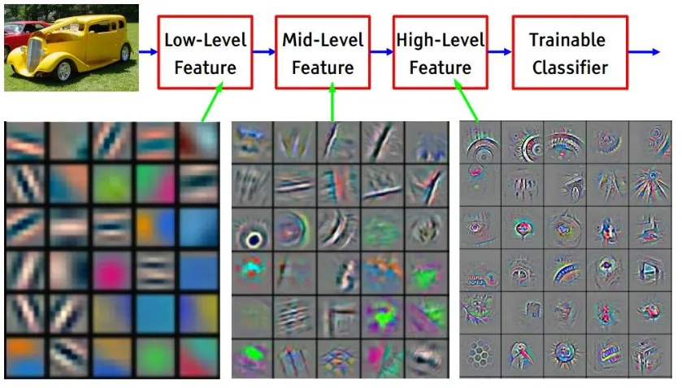
An Example of Feature Detection
https://towardsdatascience.com/build-your-own-convolution-neural-network-in-5-mins-4217c2cf964f

Slide 72
More than an RGB Image
The original object can be more than an RGB image.
The original object can be anything represented as a multilayer matrix n₁ x n₂ x n_{C} where n_{C} is the number of channels (layers).
Each filter can be f x f x n_{C}. You remember that a filter is square (f₁ = f₂ = f) and the number of layers (channels) in the filter must be equal to the number of layers (channels) in the original matrix n_{C}.
We may apply multiple filters n_{F} (features) thus, the convolutional layer will be of size ((n₁+2p-f)/s + 1) x ((n₂+2p-f+s)/s + 1) x n_{F} .
The number of channels in the original object n_{C} does not impact the size of the convolutional layer; it only impacts the number of layers in the filters.

Slide 73
Convolutional Layer with Multiple Filters
Filter 1
Convolution 1
Original matrix
=
*
f x f x n_{C}
c₁ x c₂
Convolutional Layer
Filter 2
Convolution 2
*
=
f x f x n_{C}
c₁ x c₂
… …
c₁ x c₂ x n_{F}
Filter n_{F}
Convolution n_{F}
c₁ = n₁ - f + 1
c₂ = n₂ - f + 1
*
=
n₁ x n₂ x n_{C}
f x f x n_{C}
c₁ x c₂

Slide 74
Convolutional Layer: Padding, Strides, and Multiple Filters
Filter 1
Convolution 1
Original matrix
=
*
f x f x n_{C}
c₁ x c₂
Convolutional Layer
Filter 2
Convolution 2
*
=
f x f x n_{C}
c₁ x c₂
… …
c₁ x c₂ x n_{F}
Filter n_{F}
Convolution n_{F}
*
=
n₁ x n₂ x n_{C}
f x f x n_{C}
c₁ x c₂

Slide 75
Convolutional Layer for an Original Object with a Single Channel
The original object can be represented with a single channel (layer).
Multiple filters applied to the original matrix may produce a multifeatured convolutional layer.
Thus, a convolutional layer represents features embedded in the original object rather than channels in it.

Slide 76
Convolutional Layer: 2D Original Matrix
Filter 1
Convolution 1
*
=
Original matrix
f x f
c₁ x c₂
Convolutional Layer
Filter 2
Convolution 2
*
=
f x f
c₁ x c₂
… …
c₁ x c₂ x n_{F}
n₁ x n₂
Filter n_{F}
Convolution n_{F}
c₁ = n₁ - f + 1
c₂ = n₂ - f + 1
*
=
f x f
c₁ x c₂

Slide 77
Convolutional Layer: 2D Original Matrix - Padding, Strides, and Multiple Filters
Filter 1
Convolution 1
*
=
Original matrix
f x f
c₁ x c₂
Convolutional Layer
Filter 2
Convolution 2
*
=
f x f
c₁ x c₂
… …
c₁ x c₂ x n_{F}
n₁ x n₂
Filter n_{F}
Convolution n_{F}
*
=
f x f
c₁ x c₂

Slide 78
Building a Convolutional Layer in Neural Network

Slide 79
Convolutional Layer with Multiple Filters
Filter 1
Convolution 1
n_{C} is the number of channels
n_{F} is the number of features
f = 3 is the filter linear size.
RGB image
=
*
3 x 3 x n_{C}
c₁ x c₂
Convolutional Layer
Filter 2
Convolution 2
*
=
3 x 3 x n_{C}
c₁ x c₂
… …
c₁ x c₂ x n_{F}
Filter n_{F}
Convolution n_{F}
n₁ x n₂ x n_{C}
*
=
c₁ = n₁ - f + 1 = n₁ - 2
c₂ = n₂ - f + 1 = n₂ - 2
3 x 3 x n_{C}
c₁ x c₂

Slide 80
Building Convolutional Layer
Filter 1
Convolution 1
RGB image
*
Z₁^{[1]} = + b₁^{[1]}
A₁^{[1]} = ReLU(Z₁^{[1]})
3 x 3 x n_{C}
c₁ x c₂
Filter 2
Convolution 2
*
Z₂^{[1]} = + b₂^{[1]}
A₂^{[1]} = ReLU(Z₂^{[1]})
…
c₁ x c₂
3 x 3 x n_{C}
…
…
Filter n_{F}
Convolution n_{F}
n₁ x n₂ x n_{C}
*
Zn_{F} ^{[1]} = + bn_{F} ^{[1]}
An_{F}^{[1]} = ReLU(Zn_{F}^{[1]})
3 x 3 x n_{C}
c₁ x c₂
X W^{[1]} Z^{[1]} A^{[1]}
x₁
x₂
…
…
x_{Nx}

Slide 81
Convolutional Layer Explained
X W^{[1]} Z^{[1]} A^{[1]}
Filter 1
Feature 1
x₁
x₂
Filter 2
Feature 2
…
…
…
…
x_{Nx}
Filter n_{F}
Feature n_{F}
Convolutional layer

Slide 82
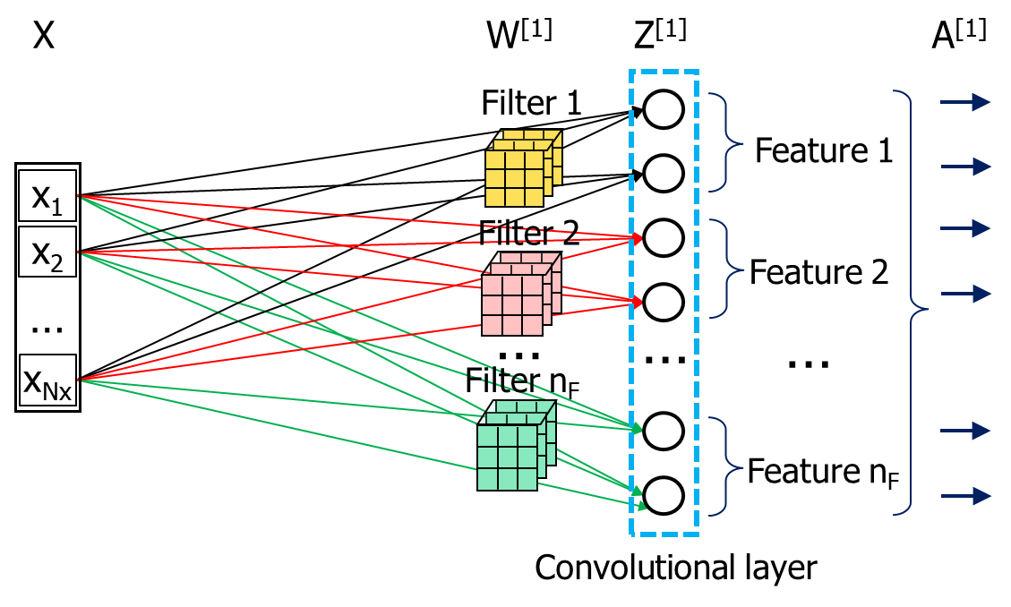
Convolutional Layer Explained
A convolutional layer in this example comes directly form the input vector X.
A convolutional neural network may have many convolutional layer which are receiving input from internal layers of the network.

Slide 83
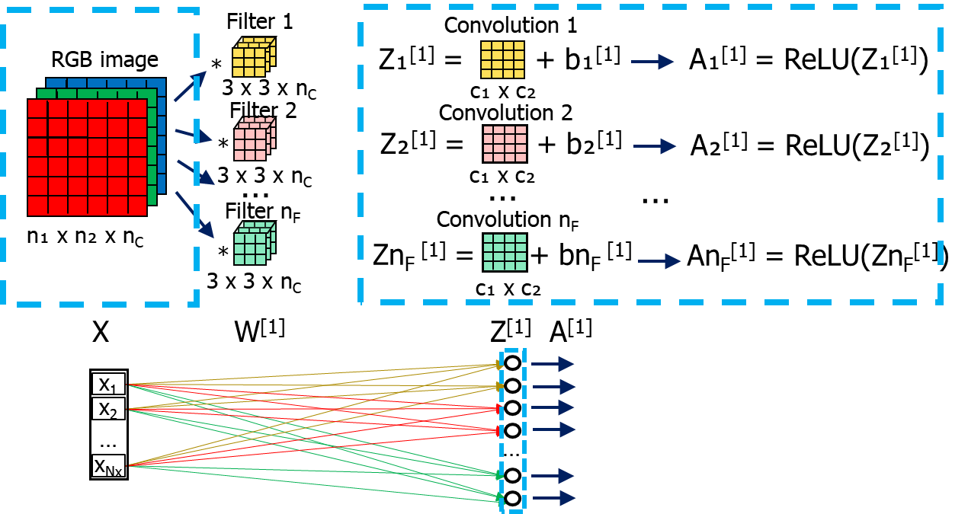
How Many Parameters are in a Convolutional Layer?
Suppose we have
an RGB image of size n₁ x n₂ with n_{C} channels, i.e. n₁ x n₂ x n_{C}.
n_{F} filters f x f each (1 per feature)
No padding, no striding
How many parameters does the convolutional layer have?
Each filter has f x f x n_{C} parameters plus one bias b per filter. Totally f x f x n_{C} +1 parameters.
There are n_{F} filters, thus the total number of parameters are (f x f x n_{C} +1) n_{F}.
The total number of neurons in the convolutional layer is n_{F} times the size of the convolution per each feature, i.e. n_{F}(n₁-f+1)(n₂-f+1).

Slide 84
Example: Parameters are in a Convolutional Layer?
Suppose we have
A 6 x 6 RGB image with 3 channels, i.e. 6 x 6 x 3.
10 filters 3 x 3 each (1 per feature)
No padding, no striding
Each filter has 3 x 3 x 3 = 27 parameters plus one bias b per filter. Totally f x f x n_{C} +1 = 28 parameters per feature (convolution).
There are 10 filters, thus the total number of parameters are 28 * 10 = 280.
The total number of neurons in the convolutional layer is 10 times the size of the convolution per each feature, i.e. 10 * 16 = 160.

Slide 85
The Sense of Convolutional Layers
Filters extract specific features from the original object and automatically populate the convolutional layer with those features.
The convolutional layer can be used for the object recognition by those features or for further feaure extraction in the next convolutional layers.

Slide 86
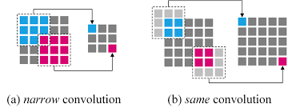
Valid and Same Convolution
In valid or narrow convolution, the size of the output shrinks at each layer.
So after some point of time additional layers cannot meaningfully performs convolution.
For this reason, same convolution is introduced, where the initial image n x n is padded, so the size of the output remains intact n x n.

Slide 87
Chapter 13 – Convolutional Layer

